Slide 1
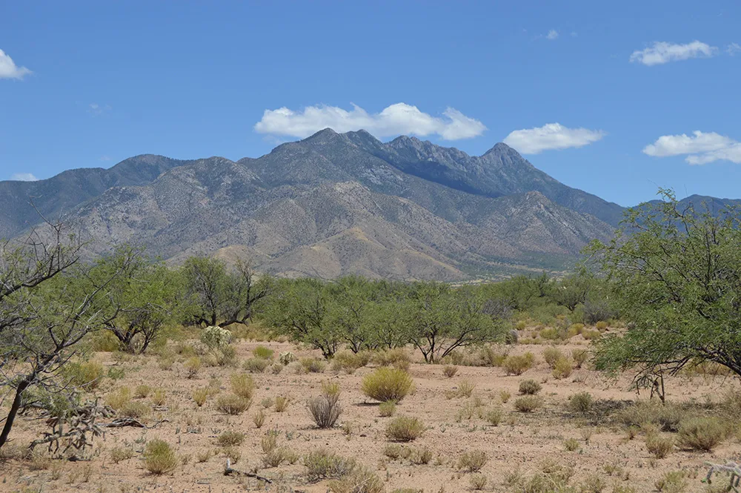
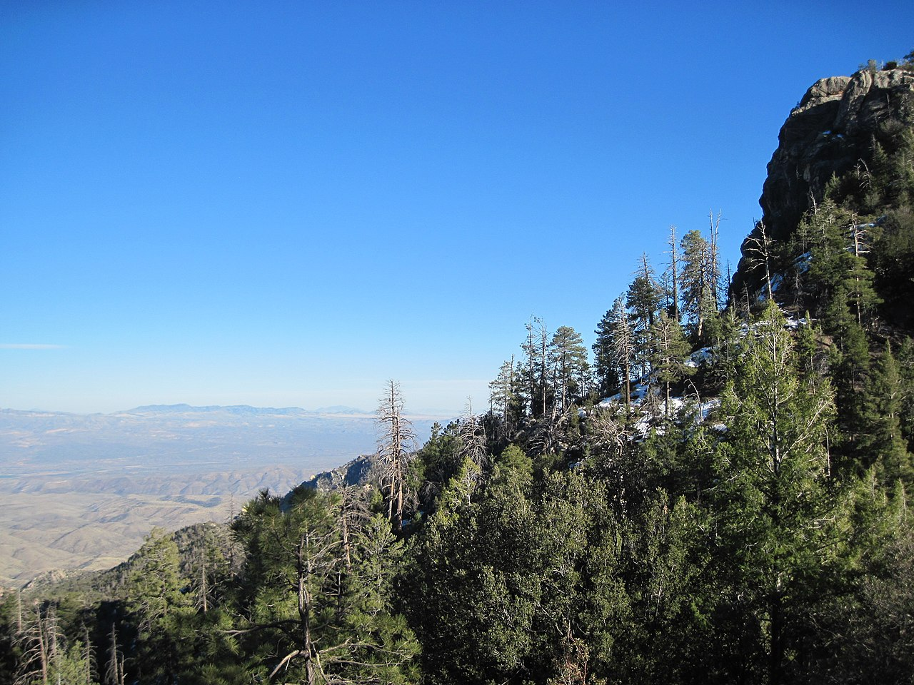
Sky Islands of the Southwest
Eric Gibson
Image Source: https://www.frontierbotany.info/projects/madrean-sky-islands/
Image Source: https://en.wikipedia.org/wiki/Sky_island

Slide 2
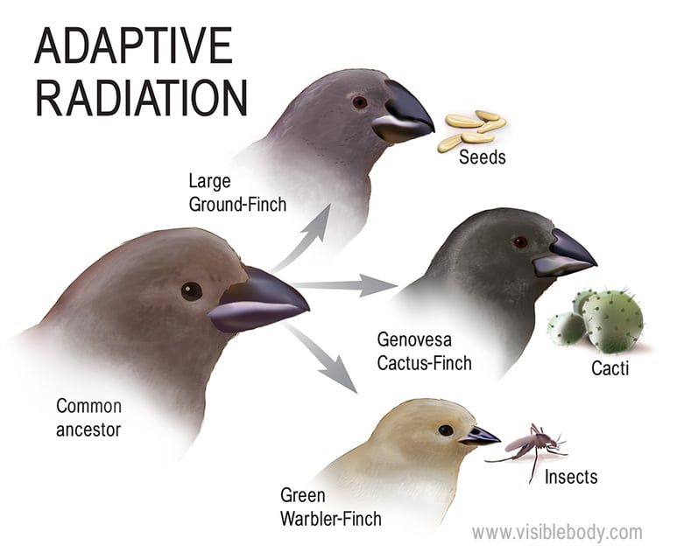
Island Biogeography
Island Biogeography
How islands affect living organisms through evolution - certain species will evolve on different islands depending on resources available
The most famous example are the Galapagos finches discovered by Darwin
It is important to note that “islands”, in this case, is essentially anywhere where species are cut off by an unsuitable environment surrounding them
Ex: a lake, alpine tundra, land surrounded by a canyon, etc.
Image Source: https://www.visiblebody.com/blog/darwins-finches-keep-evolving

Slide 3
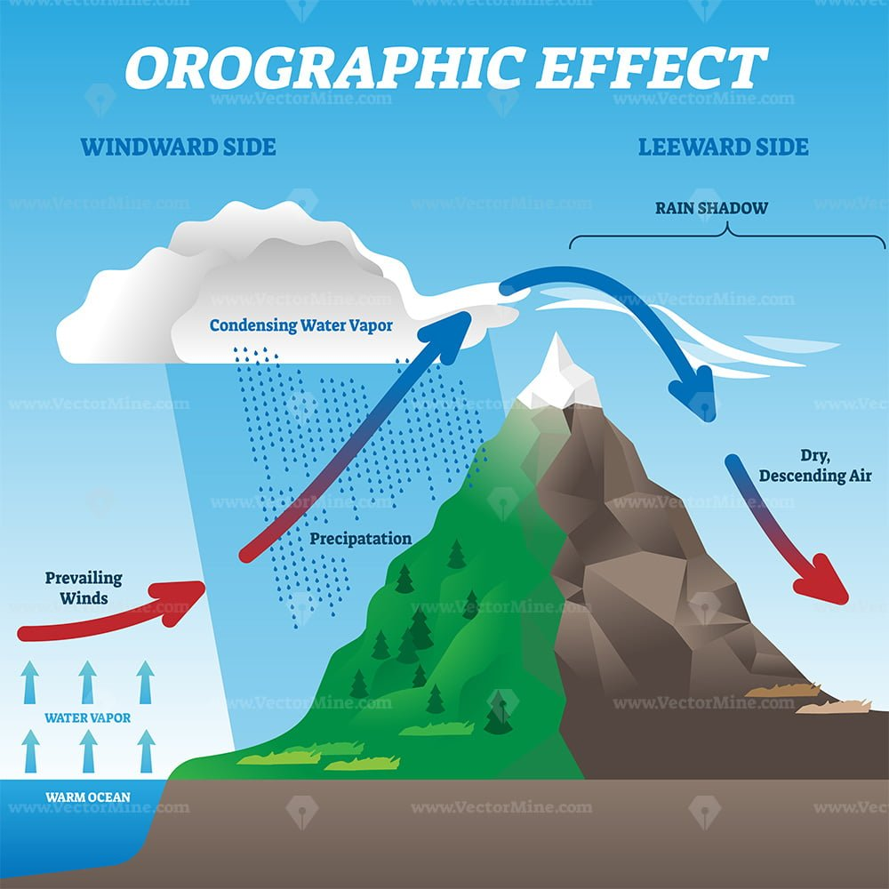
What are “Sky Islands”?
Through a process called orographic lifting, air masses rise up slopes and cool, causing moisture within those air masses to condense and precipitate on the tops of mountains
In areas like the Southwestern United States and Northern Mexico, there are many small mountain ranges where orographic lifting occurs, allowing for the growth of vegetation at the peaks of those ranges
Many species have evolved on the tops of those ranges and do not live anywhere else in the world since they cannot migrate through the desolate desert at the lower elevations
Image Source: https://vectormine.com/item/orographic-effect-vector-illustration/

Slide 4
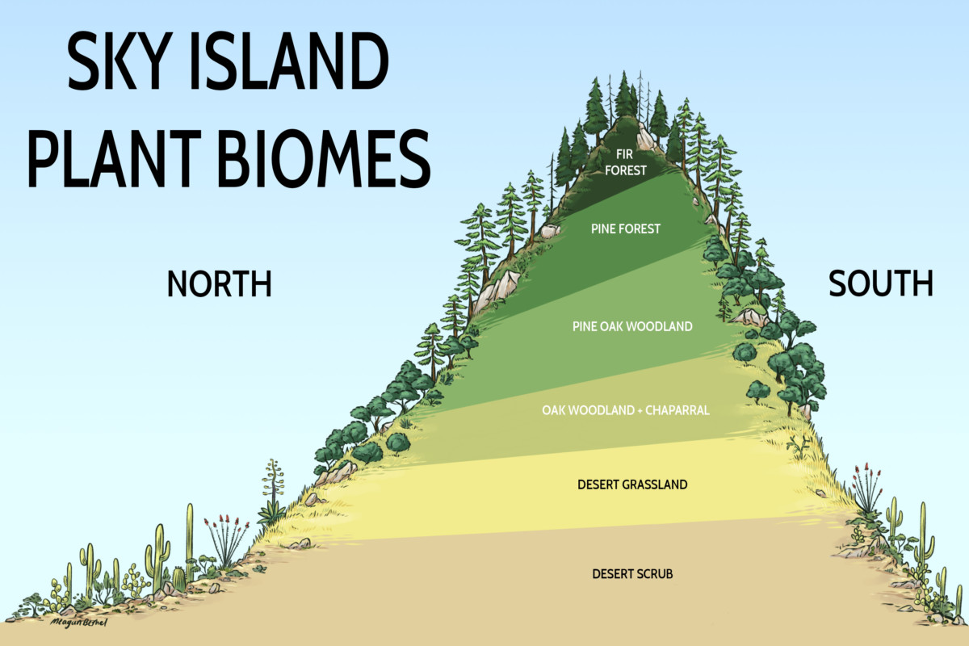
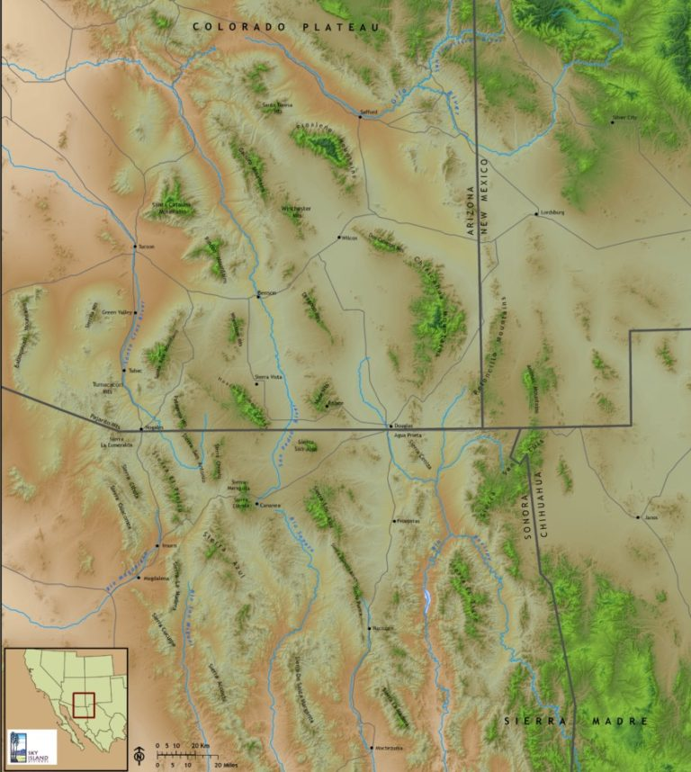
What are “Sky Islands”?
Images Source: https://skyislandalliance.org/the-sky-islands/

Slide 5
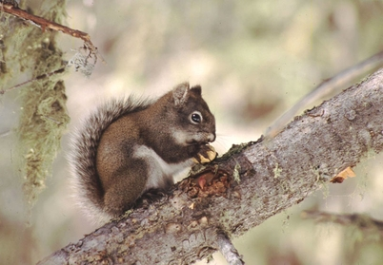
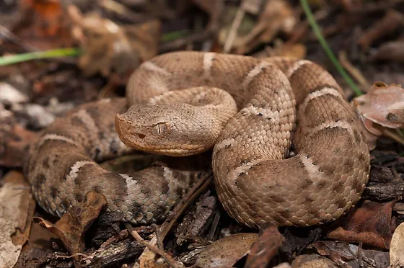
Problem Statement
Sky islands are home to many, not just native, but endemic species that have become threatened and endangered due to their limited habitat
Climate change has led to the montane forest increasing in elevation and decreasing in size on the tops of these mountains
The desert and other arid environments are advancing up the slopes, limiting the habitat for these delicate species
Mount Graham Red Squirrel
Mount Graham Red Squirrel Image Source: http://mountgraham.org/mount-graham-red-squirrels
New Mexican Ridge-Nosed Rattlesnake Image Source: https://www.savethebuzztails.org/species-accounts/New-Mexico-Ridge-nosed-Rattlesnake
New Mexican Ridge-Nosed Rattlesnake

Slide 6
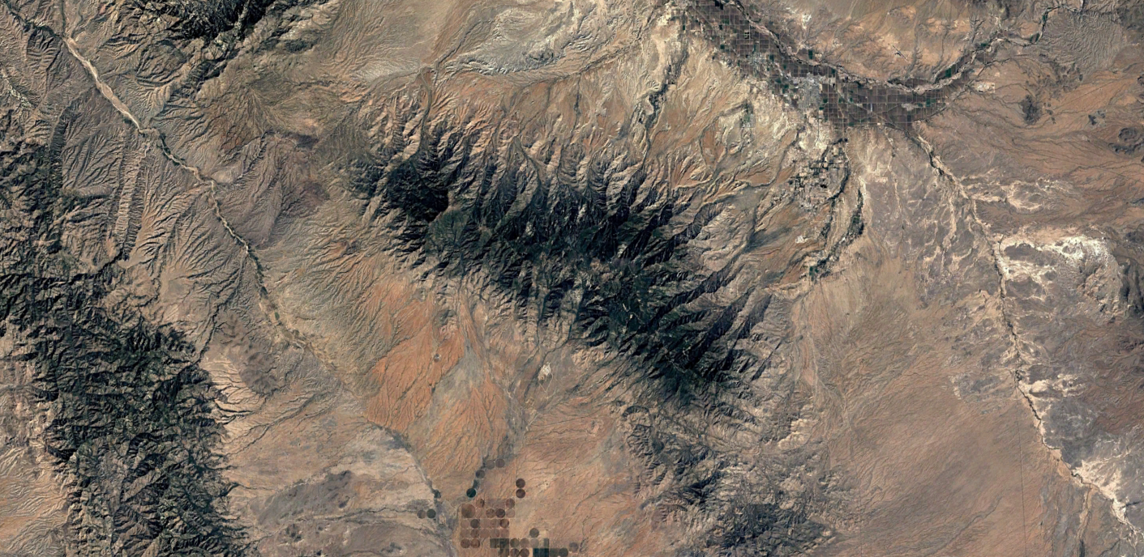
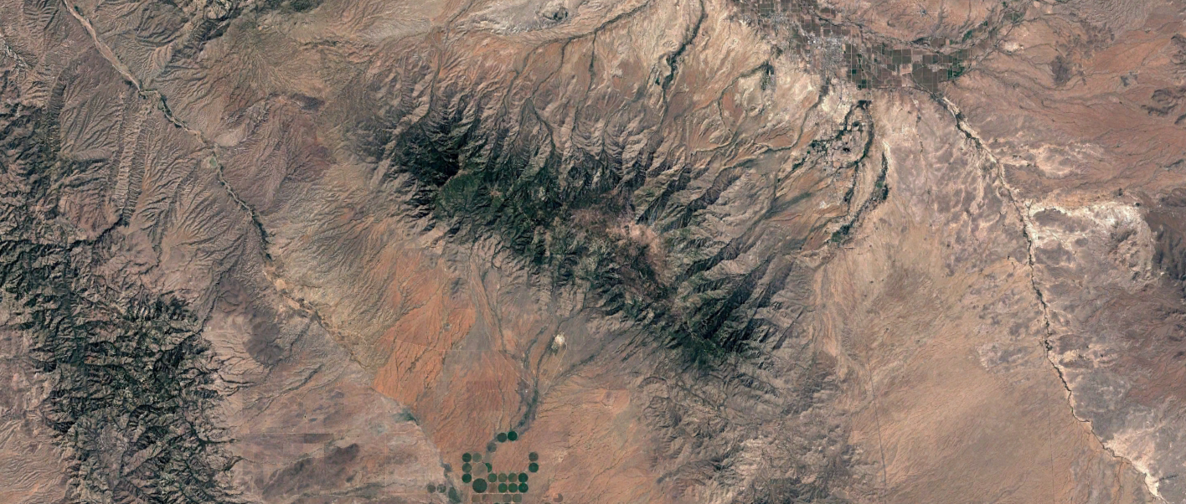
2000:
2020:

Slide 7
Why is it Important/Who Cares?
I believe it is incredibly important to protect endangered and threatened species
A loss of a certain species could also lead to possible collapse of other species
It is also important to define certain plans for environmental preservation for future possibilities
Creating a plan for protecting a sky island could allow for smaller-scale implementation of environmental protection techniques which could be used elsewhere
Lastly, protecting the environment should just be important no matter what

Slide 8
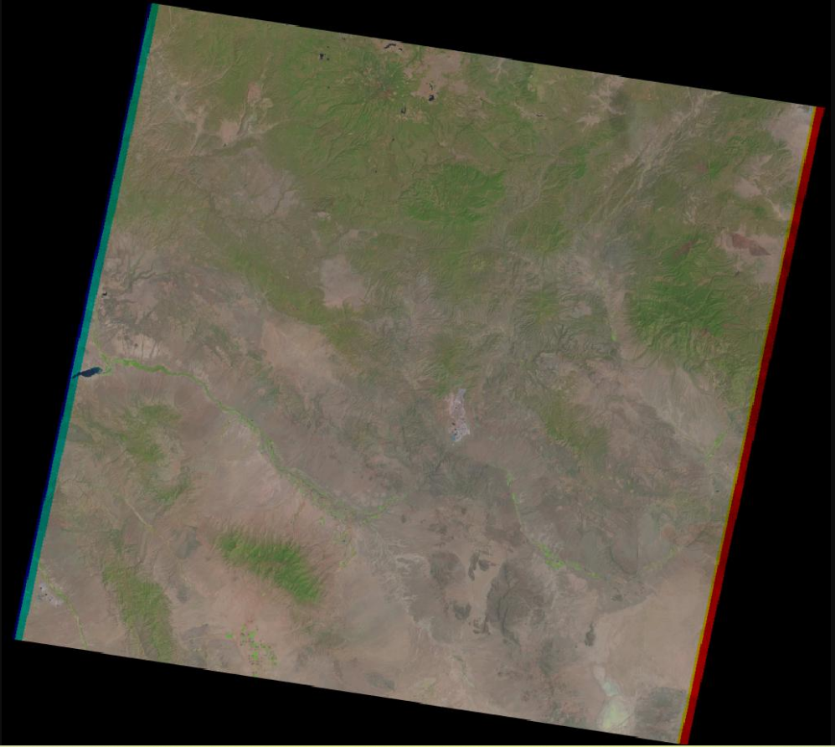
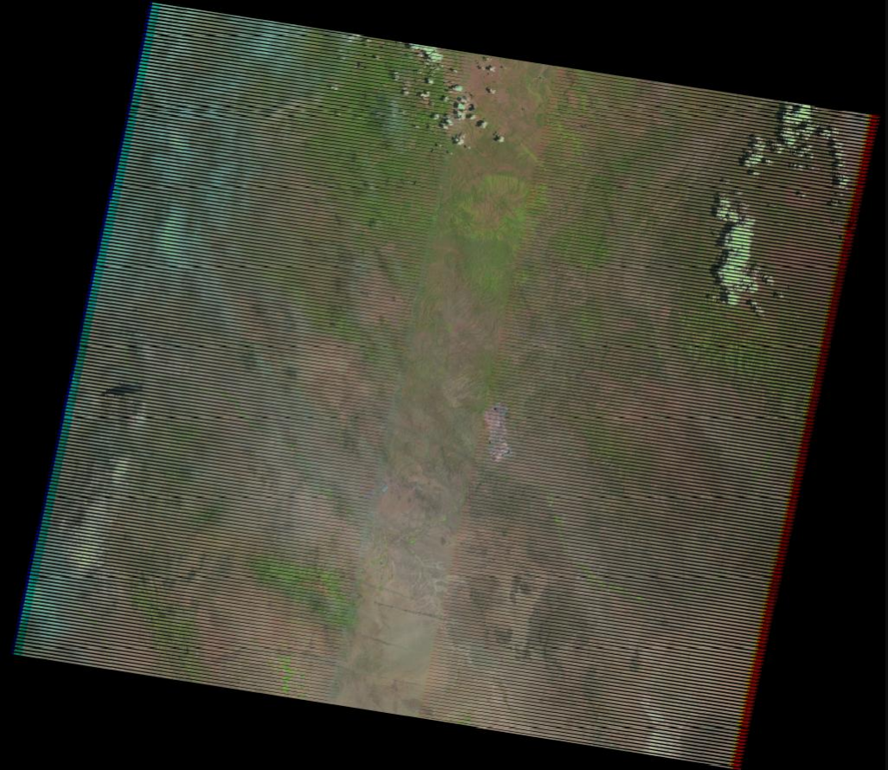
Data
For this project, I will be using Landsat 7 imagery for determining differences in vegetation between 2000 and 2020
Specifically from the dates of May 7th, 2000 and May 30th, 2020
A digital elevation model (DEM) will also be used for determining at which elevations vegetation has changed over the two decades
Also could use contours to visualize the difference better

Slide 9
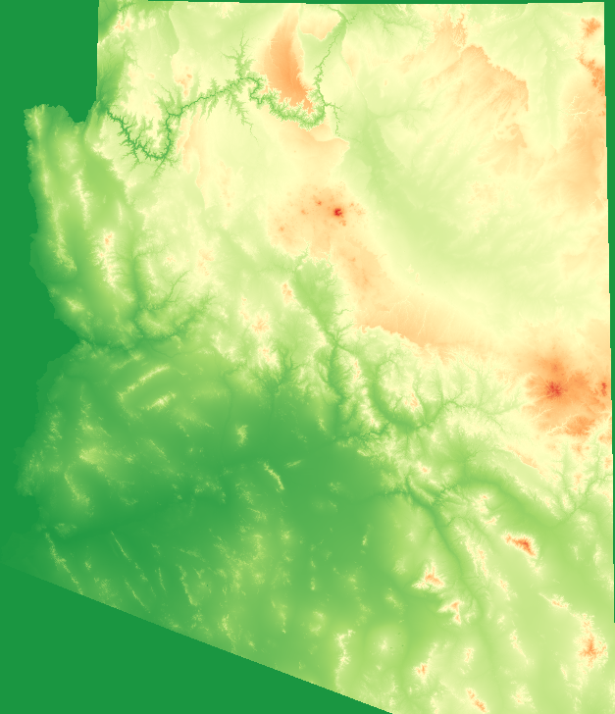
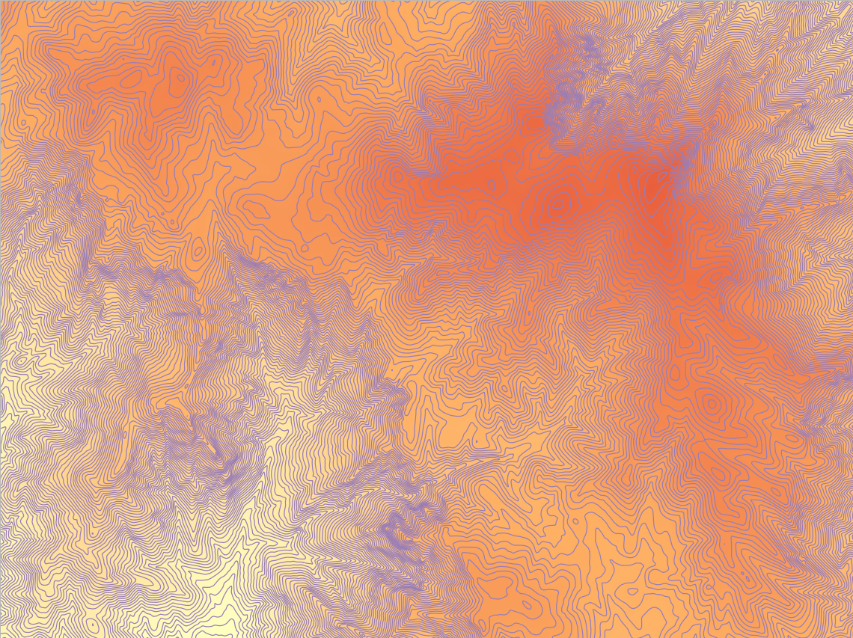
Data cont.
The satellite imagery is GeoTIFF file depicting field, raster data depicting where vegetation is located in the regions being studied
The DEM is an ADF file (raster tile layer for use in ESRI GIS products) depicting field, raster data where each cell is given a specific elevation
The contours are polylines packaged in a Shapefile where each line depicts a certain level of elevation as field, vector data

Slide 10
Data cont.
Satellite imagery
Acquired via USGS’s Earth Explorer
Taken using NASA’s and USGS’s Landsat 7 satellite with bands 3 (Red) and 4 (NIR) being used primarily
DEM
Acquired from AzGeo’s ArcGIS Online website
Formatted by ESRI and AzGeo based on data originally collected from the USGS
Contours
Acquired from AzGeo’s ArcGIS Online website
Collected by AzGeo based on data collected from the USGS

Slide 11
Metadata
Satellite imagery
Bounding box for May 7th, 2000 image:
Upper left coordinates: 34.13370, -110.28590
Upper right coordinates: 33.83750, -108.24830
Bottom left coordinates: 32.50710, -110.71210
Bottom right coordinates: 32.21620, -108.71150
Bounding box for May 30th, 2020 image:
Upper left coordinates: 34.13093, -110.31022
Upper right coordinates: 33.84028, -108.27189
Bottom left coordinates: 32.52210, -110.72800
Bottom right coordinates: 32.23681, -108.72626
Spatial resolution of both: 30 meters
Coordinate system of both: WGS 84 UTM Zone 12

Slide 12
Metadata cont.
DEM
Extent: Entire state of Arizona
Spatial resolution: 30 meters
Date of data acquisition: July 25th, 2020
Contours
Extent: Entire state of Arizona
Contour intervals: 50 feet
Date of data acquisition: April 7th, 2022

Slide 13
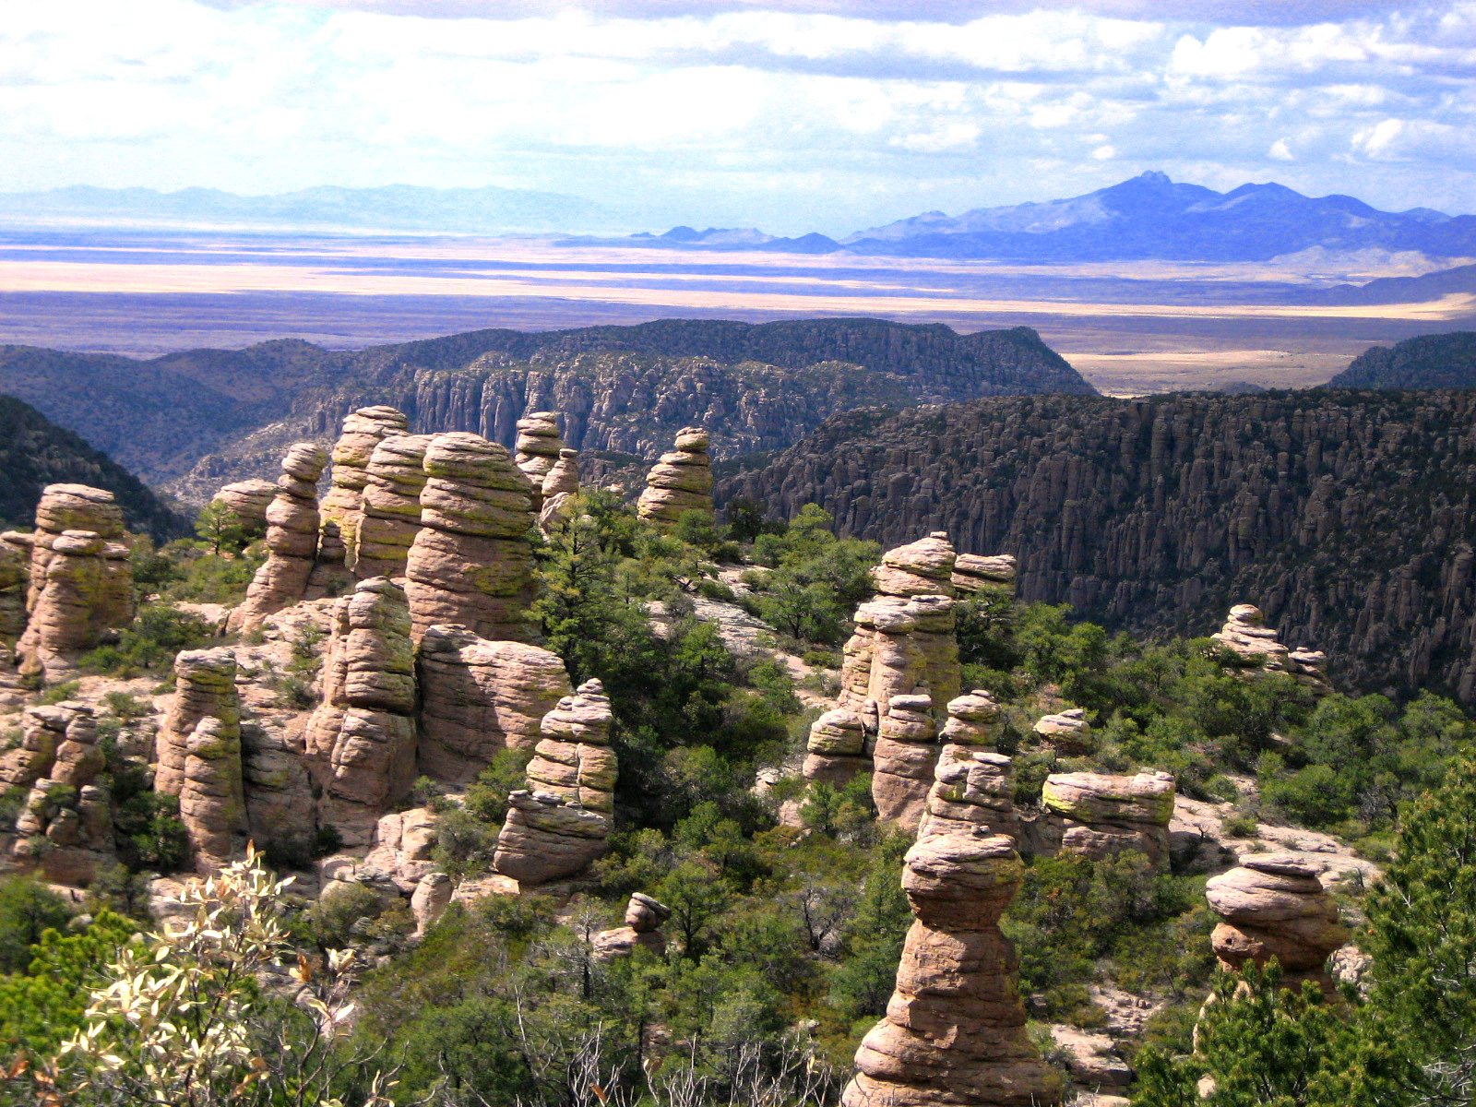
Questions?
Image Source: http://azbugztwo.blogspot.com/2013/01/sky-islands-of-arizona.html

Slide 14
References
Landsat 7 imagery courtesy of the U.S. Geological Survey
Digital elevation model data courtesy of the U.S. Geological Survey
AzGeo. 50' Contour Lines - Graham County. 2022. Shapefile.

